Slide 1
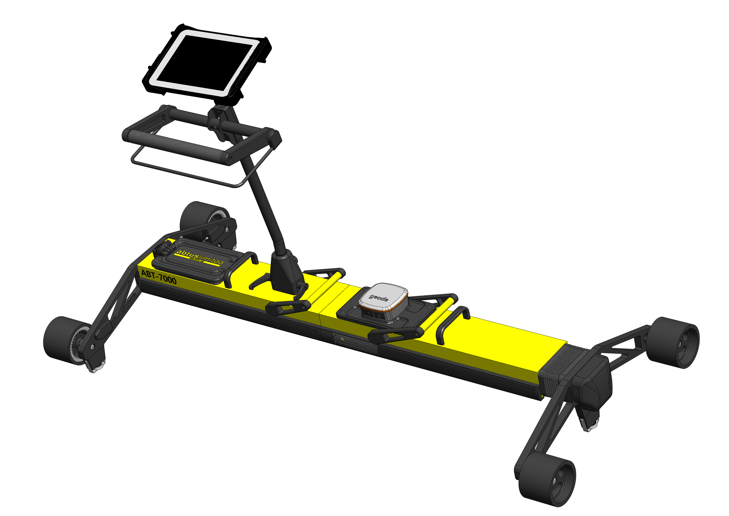
Abtus Max Cyclic Top Trolley
The way towards a cyclic top free infrastructure

Slide 2
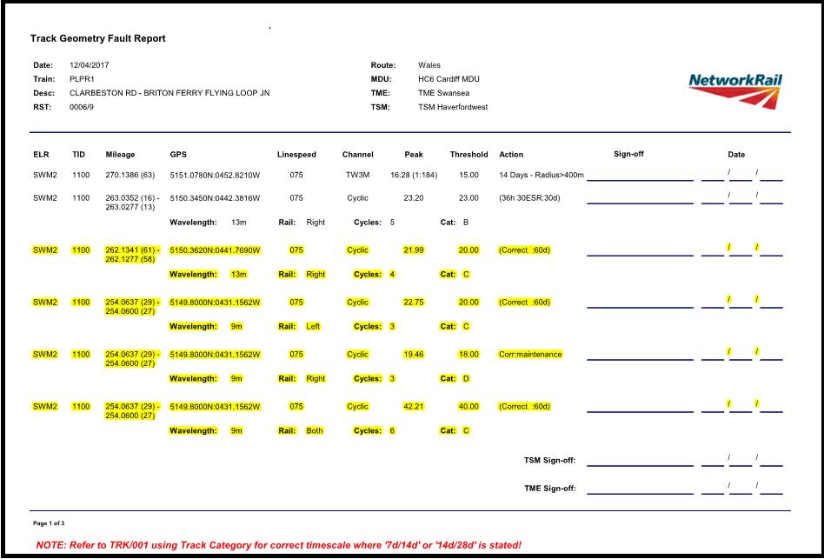
Abtus Max – The Challenge
The recording vehicle informs the maintainers of Cyclic Top sites but not the full extent of the issue or the trigger point. Consequently, teams go out and fix the reported fault on the geometry action report with little guidance, the position of the trigger point is left to the Engineer’s judgment. Maintenance teams have no means of manually checking whether their repair work has successfully removed the Risk of Cyclic Top.

Slide 3
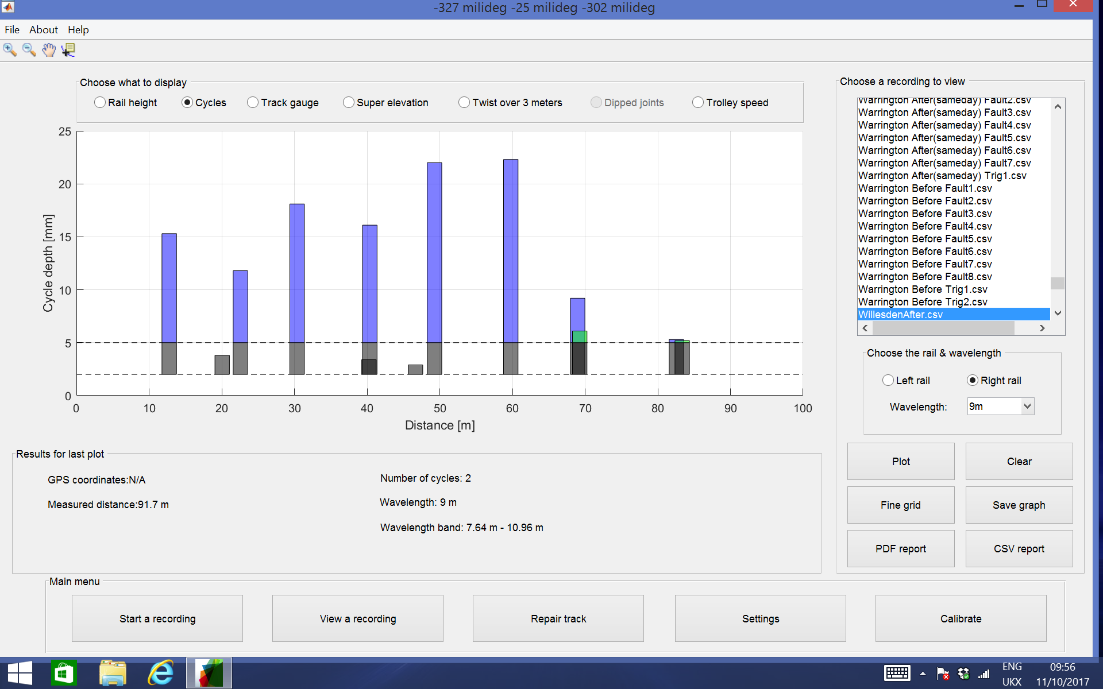
Abtus Max – Introduction
The Abtus Max will assist the maintainer in identifying the trigger point, as well as providing them with the capability to survey and scope the work required. Once the work has been carried out to repair the cyclic top issue, the trolley can measure how successful (after settlement) the work has been to enable line speed to be established quicker by reducing the need for a TRV recording.

Slide 4
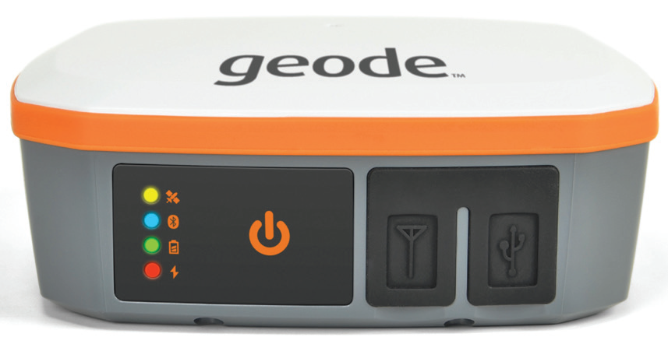
Abtus Max – The Capabilities
  Cyclic Top Identification - 4.5m, 6m, 9m, 13m & 18m Wavelengths
  Cyclic top Measurement - Left and Right Rails Measured Simultaneously
  Pre Maintenance Guidance - Live High/Low Point Identification and Lift Guidance
  Post Maintenance Inspection - Maintenance Effectiveness Analysis
  Preventative Inspection - Accurate Re-inspection Positioning via Precision GPS
  Trigger Point Identification - Locate and Measure Track Defects
  Track Geometry Recording - Gauge, Cant, Distance and Twist Measurement
  Track Geometry Reporting - Live Data Viewing/Analysis + Exportable Data

Slide 5
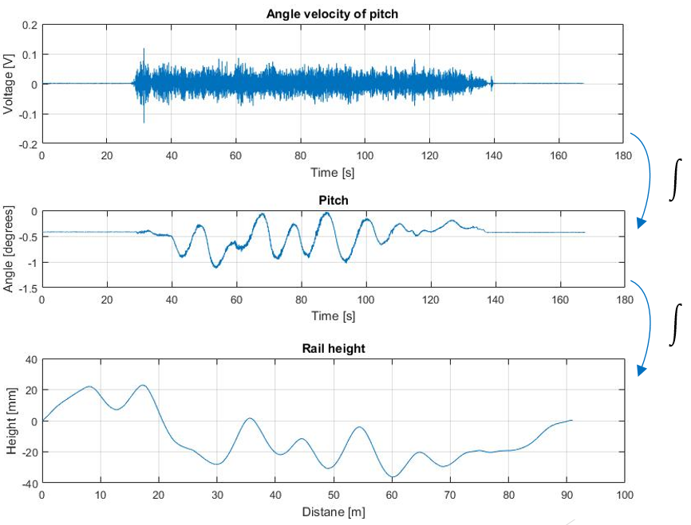
Abtus Max – Measurement Characteristics
The ABT7000 measures top faults which, when present on the track at a regular interval form Cyclic top.
Top faults are measured by calculating the vertical versine along the length of the track and identifying the peak values. The identified peaks are reported to the user as cycles and are shown on the screen as vertical bars of a height equal with the versine measured in millimetres. The chord length of the versine is selectable by the user between 4.5m, 6m, 9m, 13m and 18m and the measurement is carried out every 0.1m. The measurements are done without loading the track and thus the results are likely to differ when compared with other measurement methods such as measurement trains.
Top faults of less than 2mm in depth are not displayed to the user. Top faults have to exceed 5mm in order for the software to treat them as cycles (count them and report them). The reported cycles, depending on their position along the track, may or may not form a cyclic top fault. The software does not tell the user whether or not the cycles form a cyclic top fault, but the stars displayed on the graph can be used as a guide to see if there are three or more cycles in a regular interval.
The software will show any cycles present on the track, even if just one is present (which is not enough to form a cyclic top fault). Results are likely to differ when compared to other means of measurement such as the measurement train which reports the cycles only if they form a cyclic top fault and exceed other types of thresholds.

Slide 6
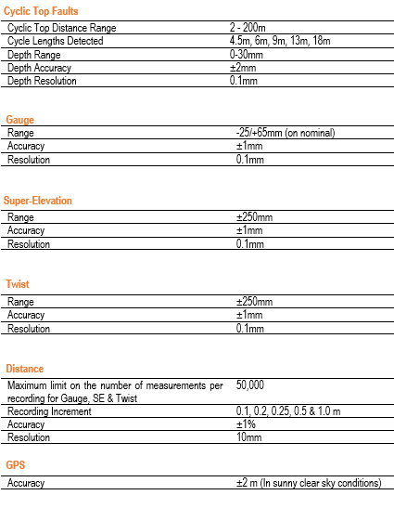
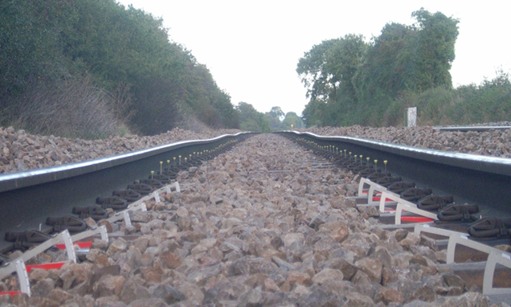
Abtus Max – Technical Specification

Slide 7
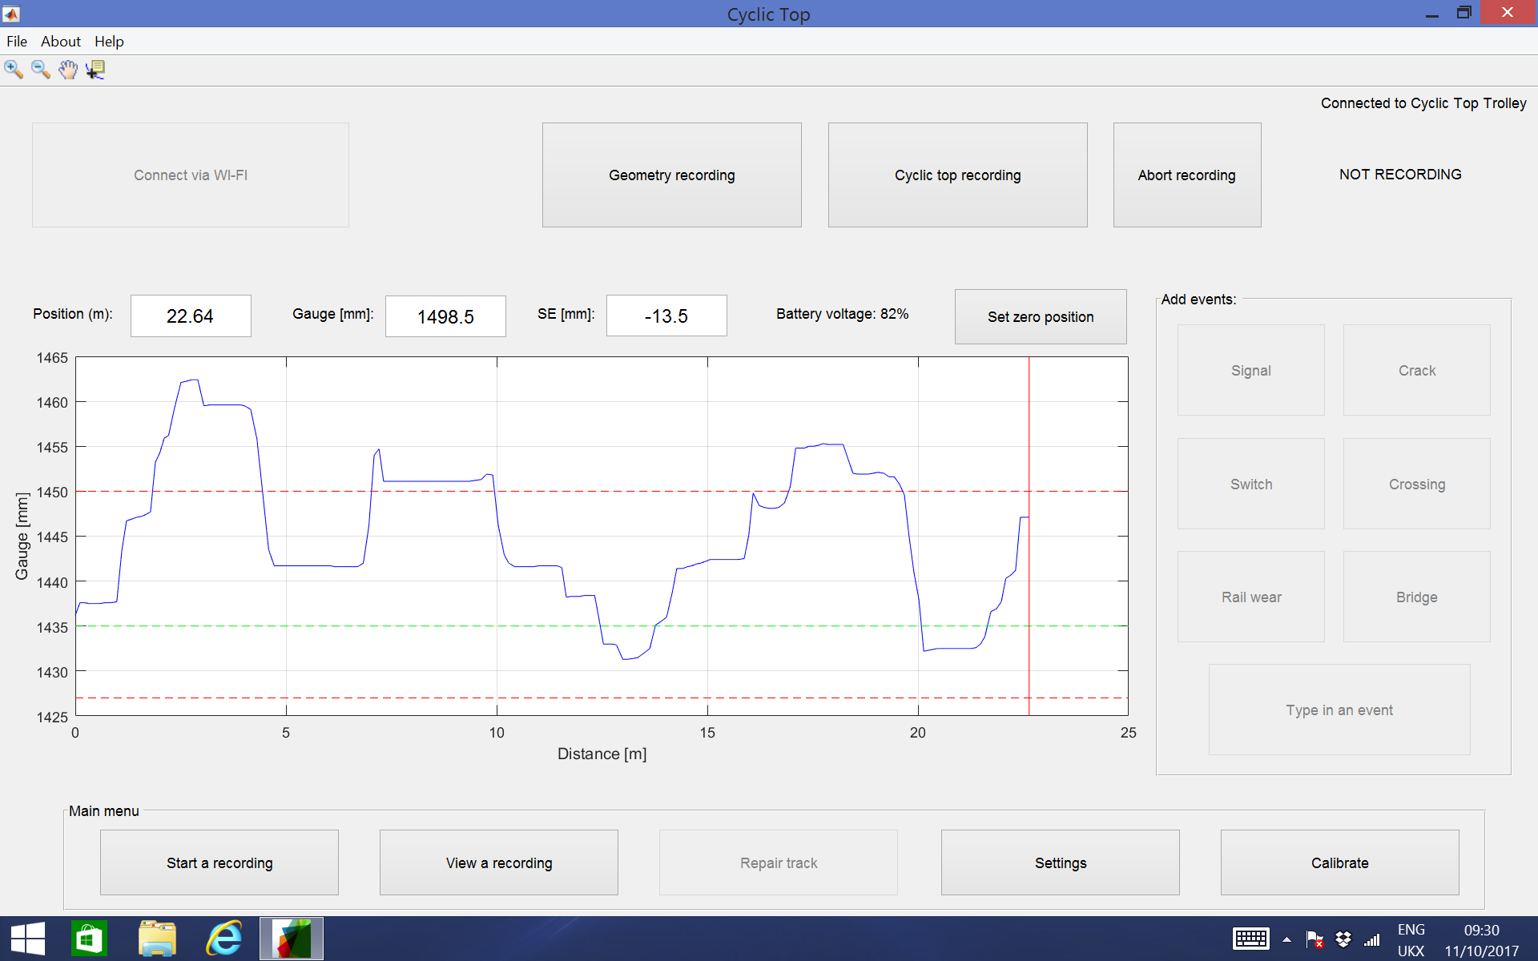
Record page (overview)
Connection status
Click connect to establish Wi-Fi connection with the trolley
Click on the graph to change it to SE

Slide 8
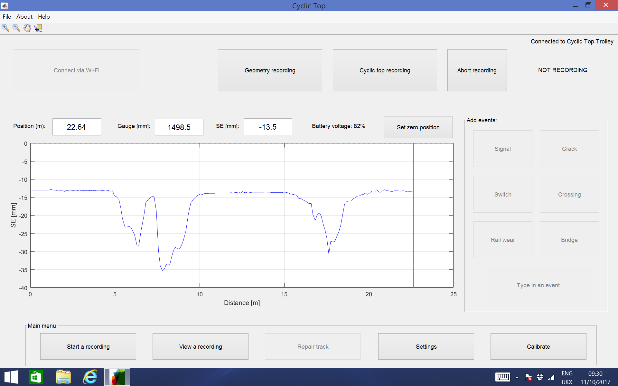
Record page (now displaying SE)
Click again to change it to twist 3m

Slide 9
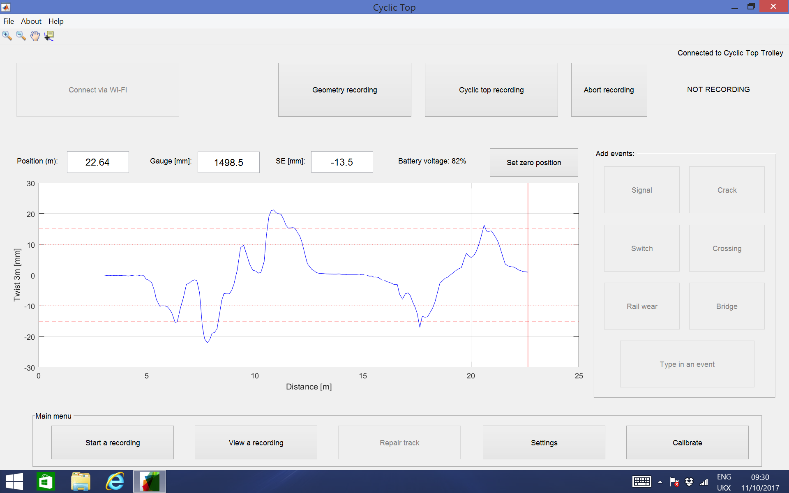
Record page (Twist 3m)

Slide 10
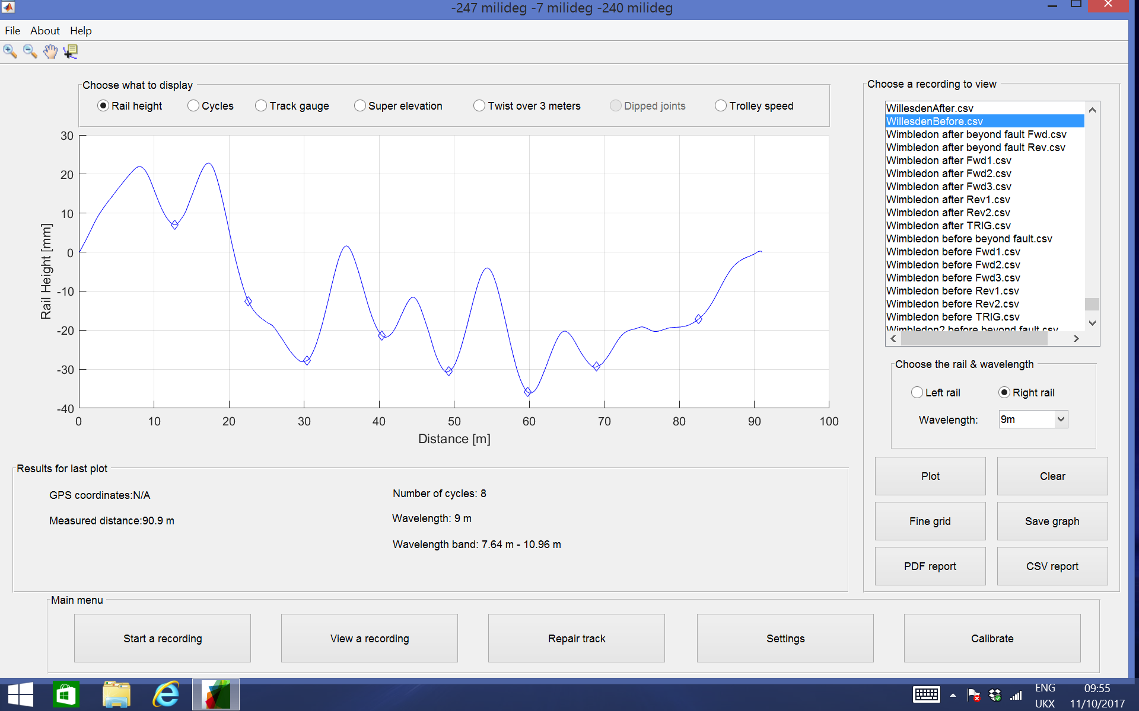
View recording page – Cyclic Top

Slide 11
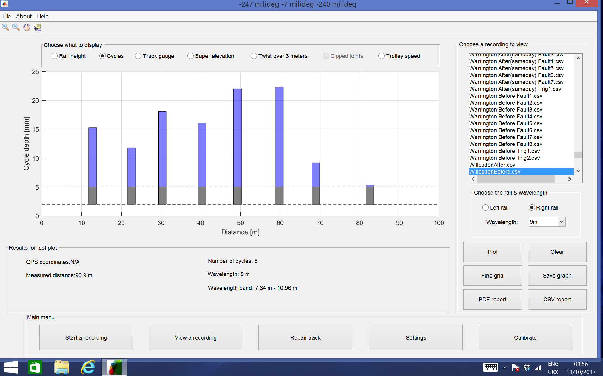
View recording page – Cyclic Top

Slide 12
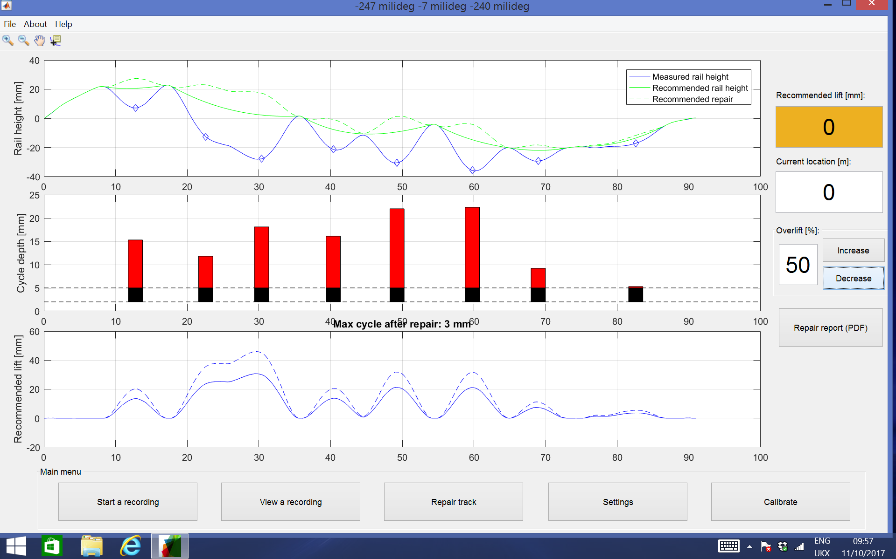
Repair page – Cyclic Top

Slide 13
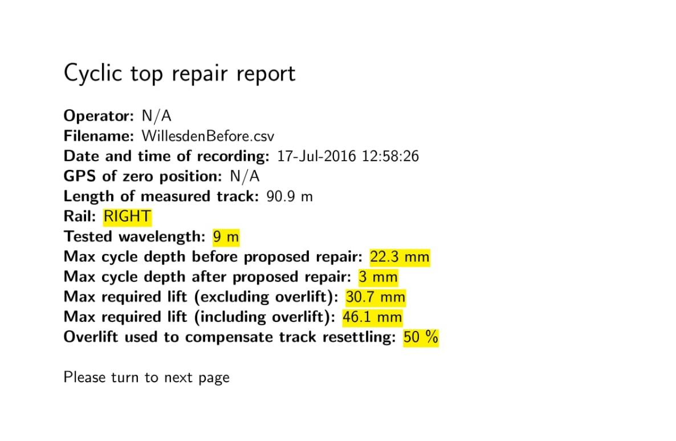
PDF repair report page 1/3 – Cyclic Top

Slide 14
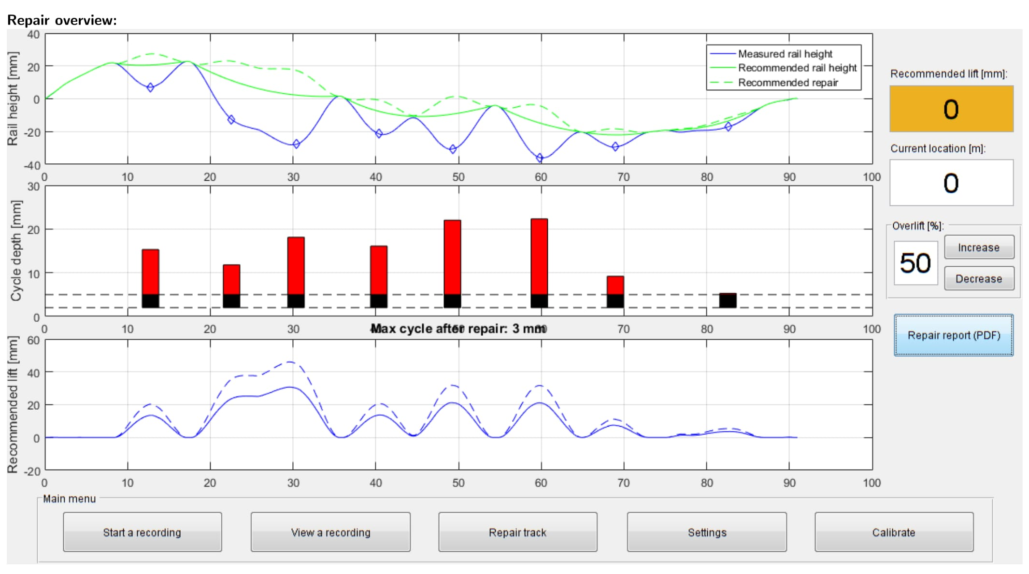
PDF repair report page 2/3 – Cyclic Top

Slide 15
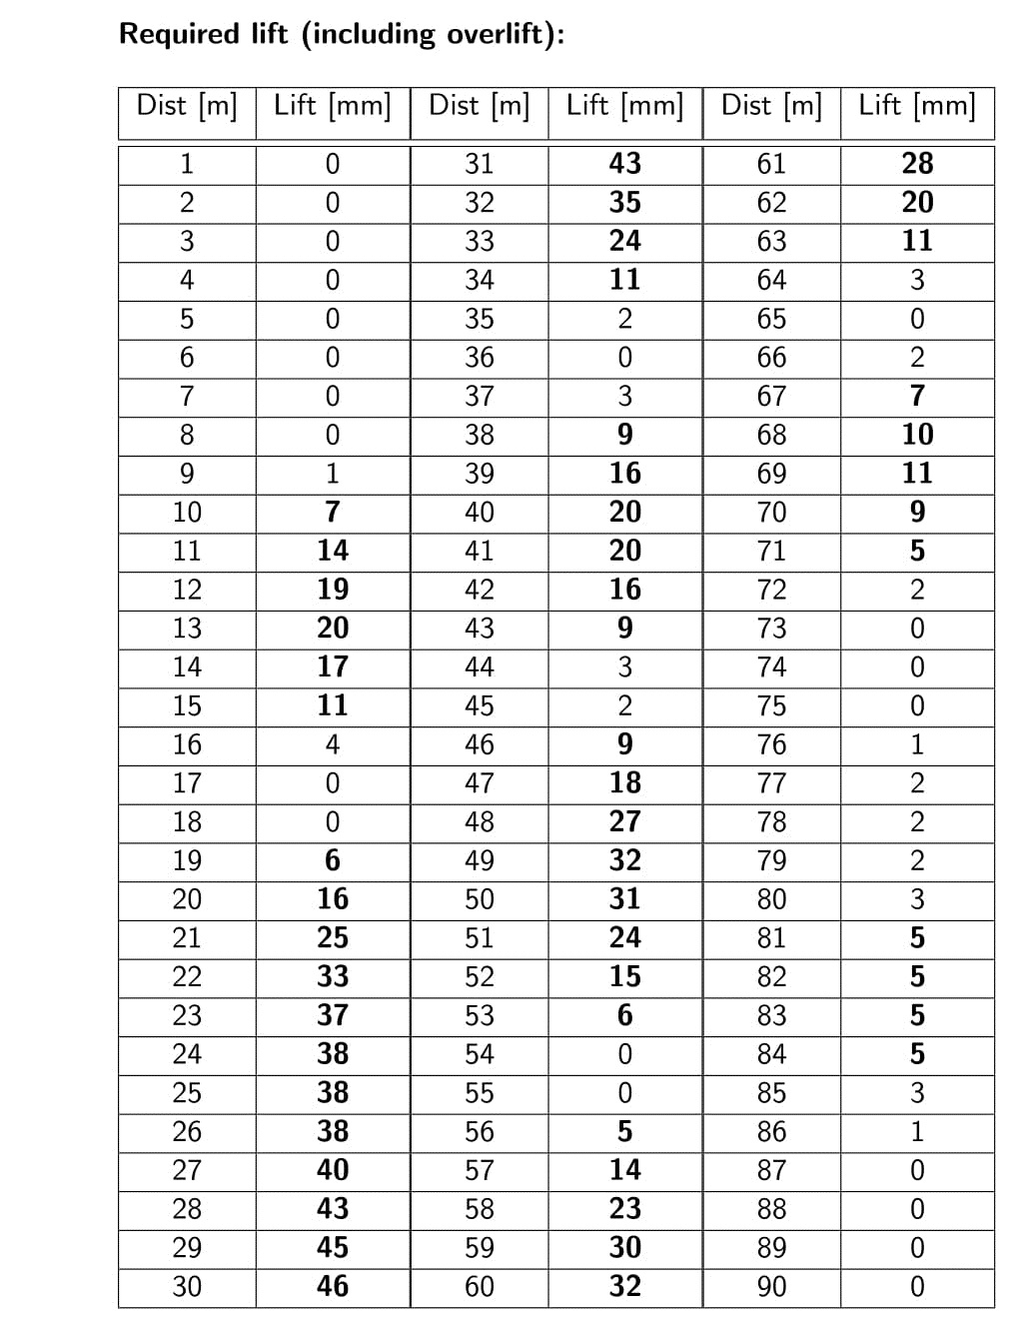
PDF repair report page 3/3 – Cyclic Top

Slide 16
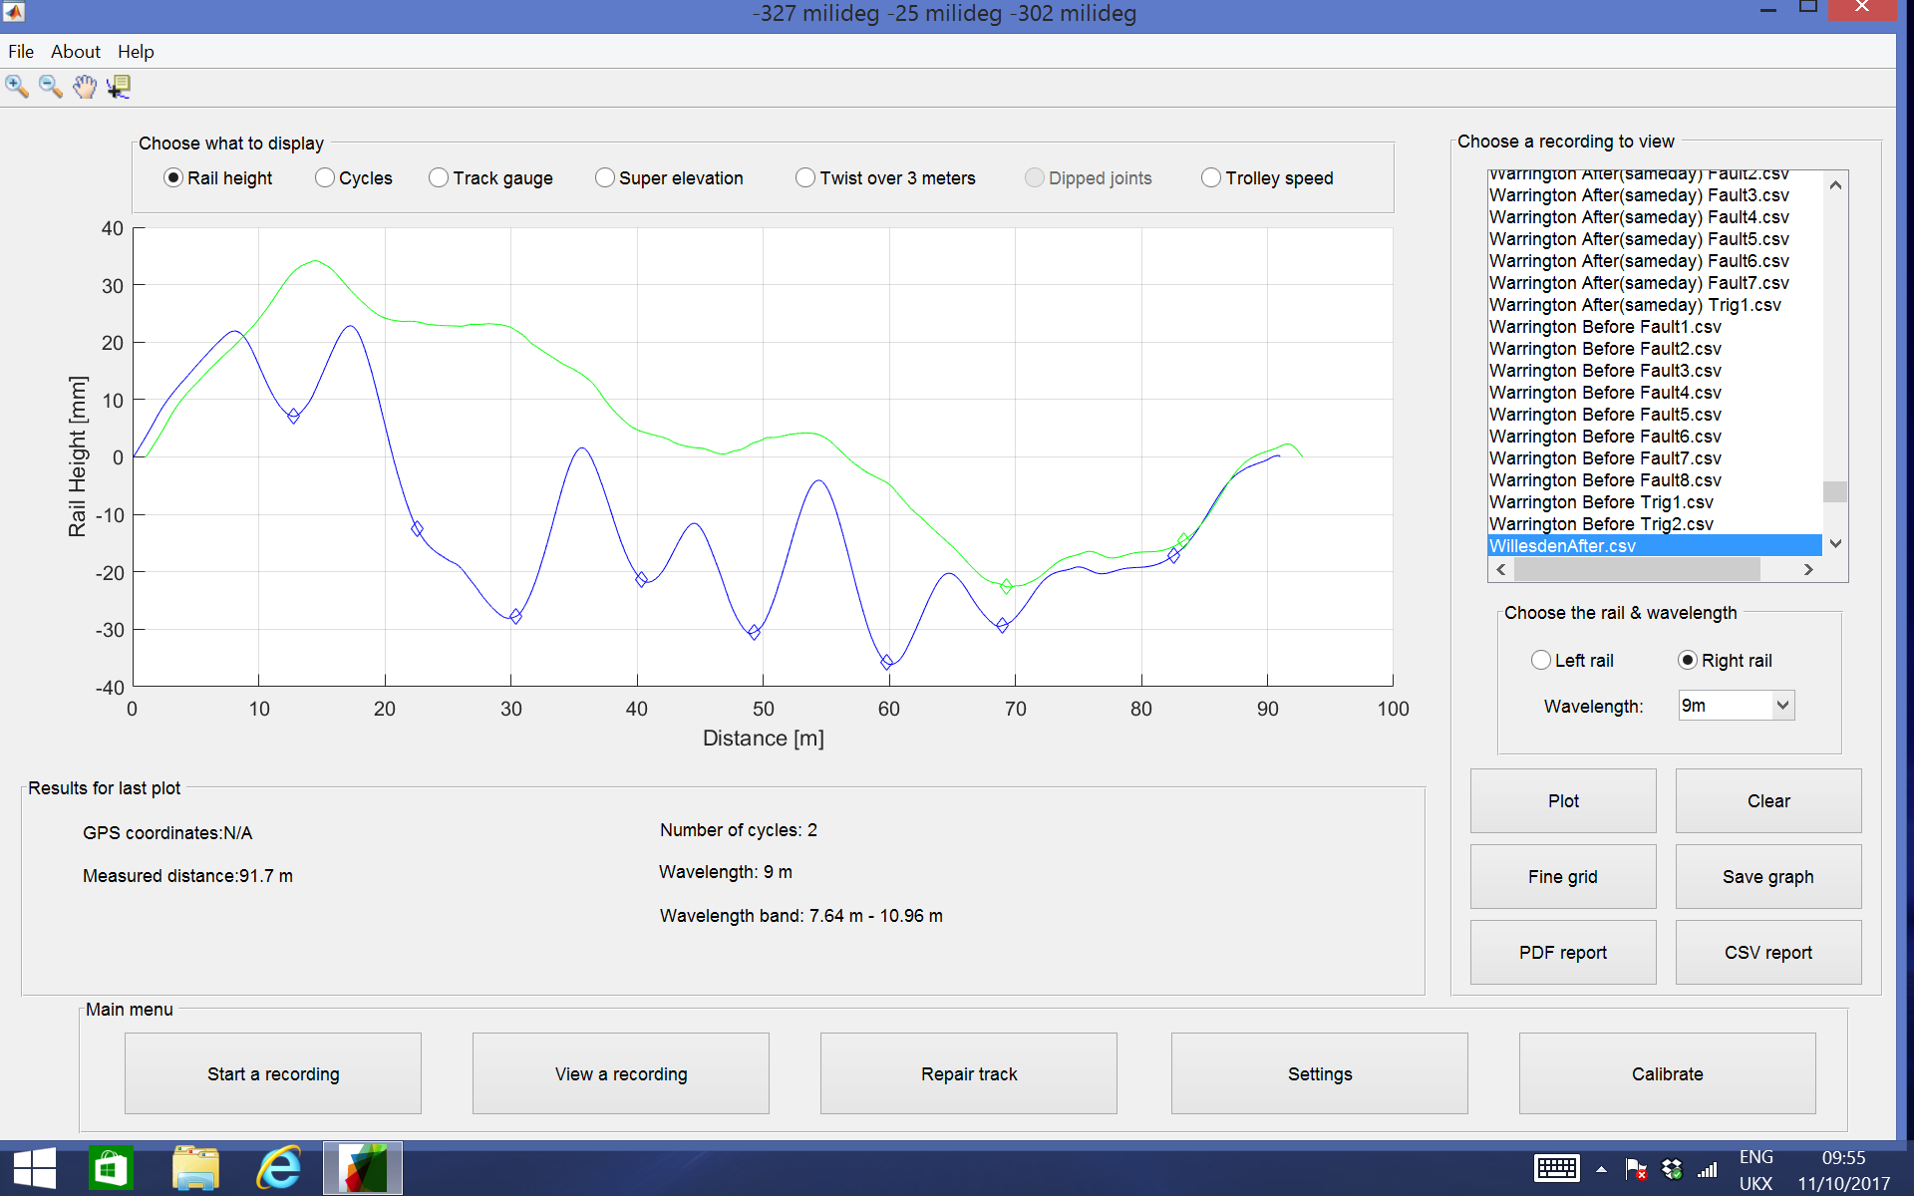
After repair comparison – Cyclic Top
Blue = before repair
Green = after repair

Slide 17
After repair comparison – Cyclic Top
Blue = before repair
Green = after repair

Slide 18
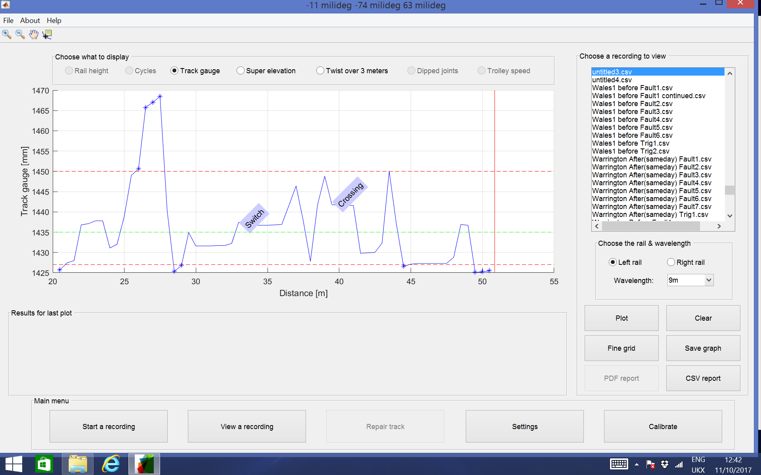
Track gauge – Geometry

Slide 19
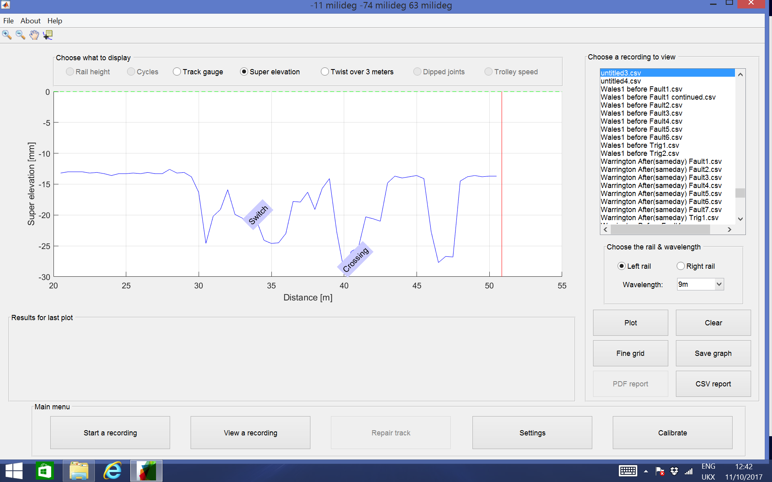
Cant – Geometry

Slide 20
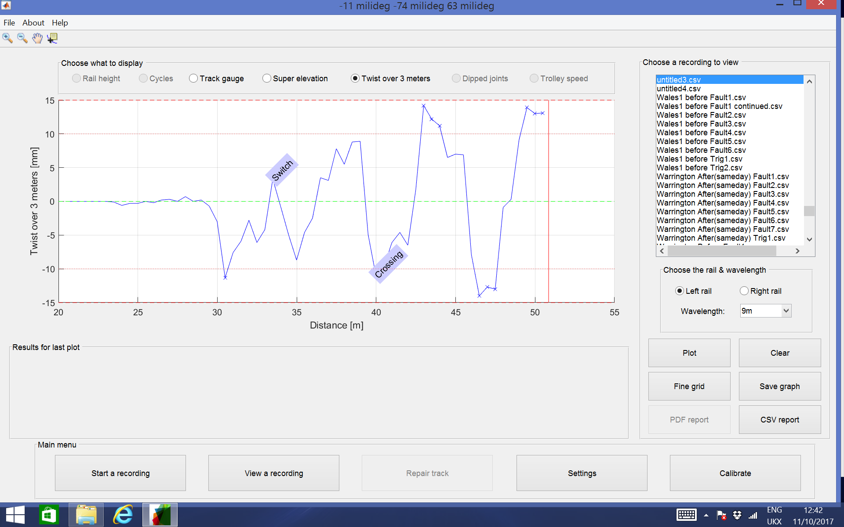
Twist 3 meters – Geometry

Slide 21
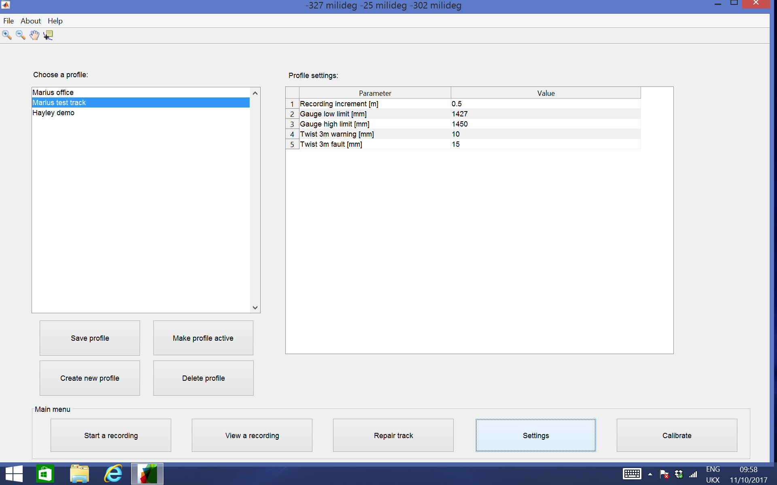
Settings/Maintenance limits – Geometry

Slide 22
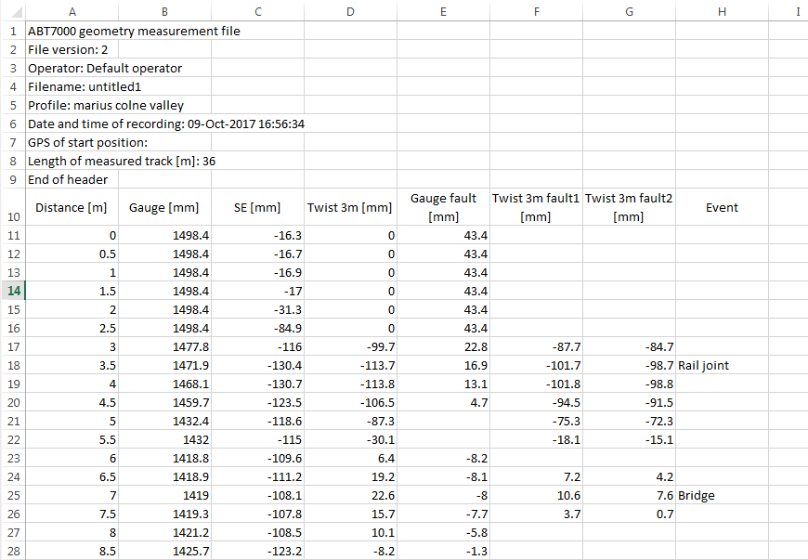
Recorded File .CSV - Geometry

Slide 23
Thank you!

